Slide 1
Legal Issues in Blockchain
Health Tech Net
September 15, 2017

Slide 2
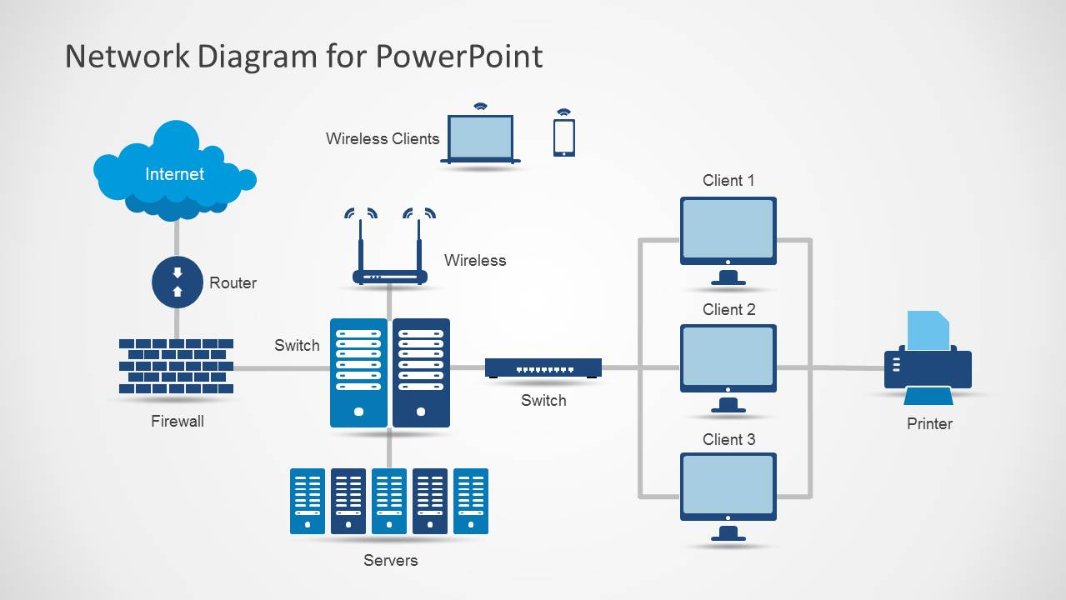
Networks—Our Current Diagrams

Slide 3

Networks—A Blockchain View?

Slide 4
The Network—"Indra's Net"
…There is a wonderful net…[and] the artificer has hung a single glittering jewel in each "eye" of the net. …If we now arbitrarily select one of these jewels…in its polished surface there are reflected all the other jewels in the net, infinite in number. Not only that, but each of the jewels reflected in this one jewel is also reflecting all the other jewels, so that there is an infinite reflecting process occurring.
Avatamsaka Sutra, 3rd c CE

Slide 5
The Irony of Blockchain
The More Information is Shared, the More Secure it Becomes
Healthcare is not the First, but May Be the Most Natural, Environment for Blockchain

Slide 6
The Nature of Healthcare
Healthcare Has Always Been about Data
Document Intensive
Critical Elements:
  Security
  Individual Control and Consent
  Trust

Slide 7
General Areas of Use Cases in Healthcare
Audit &
Compliance
Financial / Contract Mgmt
IoT
Data Liquidity
Identity Management
Essential Cross-Functional Features
Security & Confidentiality

Slide 8
Proof of Concepts
PROOFS OF CONCEPT
Audit &
Compliance
Immutable, single-source of truth from multiple enterprise sources | Logging access to PHI / Duplicate payment auditing / Regulatory billing and payment compliance / Excluded provider screenings / Three-day payment window analysis / “Sunshine Law” reporting / MACRA (MIPS) / Meaningful Use
Reduce administrative expense and delay in multiparty contractual processes | Claims Processing – medical and pharmaceutical / PBM rebate management / Physician contract management / Supply contracting / Prospective Episode-based payments / Pharma Contract Management - prompt pay and volume discounts / Beneficiary Credits/ Business Associate Agreements
Track high value assets across multiple intermediaries | Physical Sensors – Track & Trace / Provenance tracking for tissue and implantable medical devices / Equipment-as-a-Service / Equipment asset tracking / Drug Supply Chain Security Act regulations
Universal data interoperability, consumer and business enablement | PROM (Patient reported outcome measures) / Enterprise master data management / Credentialing & new credentialing models / Self-sovereign consumer health data aggregation / Upside-Down Patient Portals
Financial & Contract Mgmt
IoT
“Internet of Things”
Data
Liquidity

Slide 9
Legal and Technical Issues Addressed
Audit &
Compliance
Verification of Ledger Entries and Timestamps Security of Distributed Participation
Transaction Confidentiality Representation of Contractual Terms in Software Code
Security Potential FDA Regulation
HIPAA and Privacy Security Intersection of State, Federal Regulations and Industry Standards
Financial & Contract Mgmt
IoT
“Internet of Things”
Data
Liquidity

Slide 10
Legal and Technical Issues Raised
Governance
  De-centralized, but Controlled?
  Can Software be the “Law of the Parties”?
Privacy and Security
  HIPAA as a Barrier?
  Who is Acting on Behalf of Whom?
Fraud and Abuse
  Referral Verification
  “Smart” Regulations and Compliance?

Slide 11


